Slide 1



















































AP21110010009 | NIMSHASRI R
AP21110010043 | DHRUV SHARMA
AP21110010045 | REETHU BHARGAVI S
AP21110010839 | NAGA HAREESH B.V

Slide 2



























Slide 3





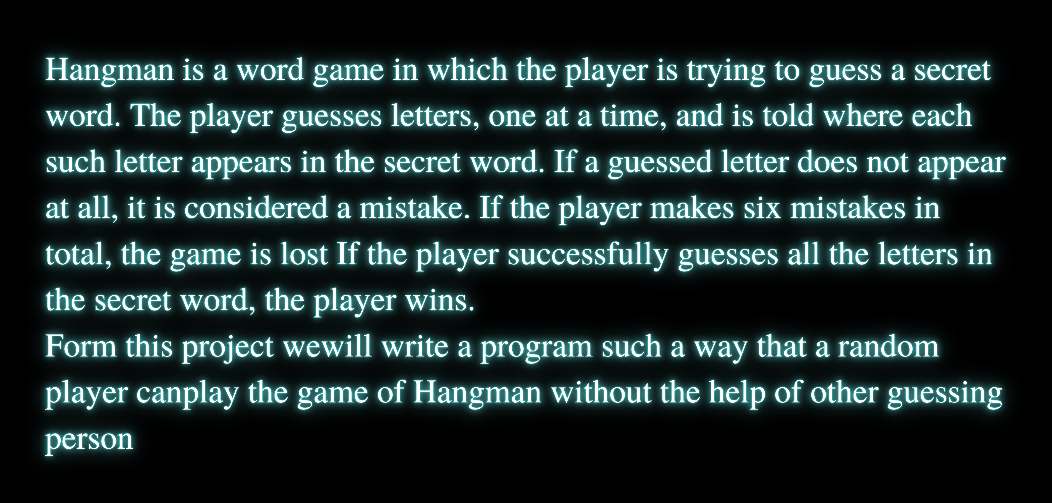






Slide 4






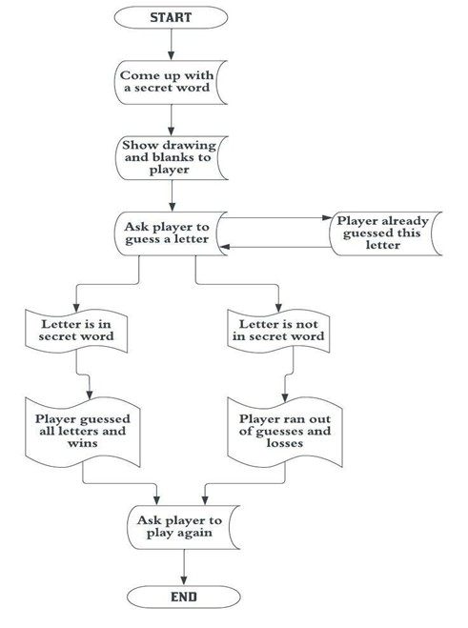









Slide 5










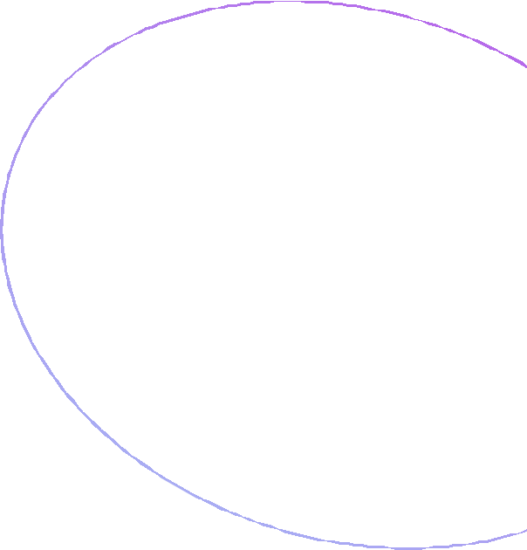



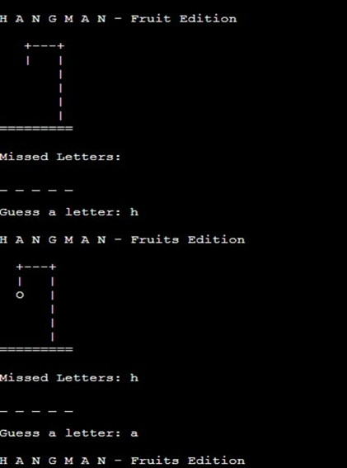
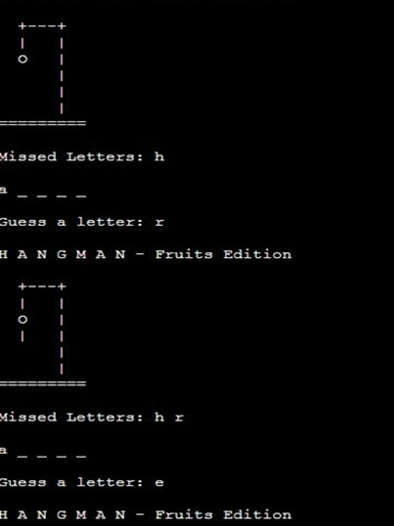

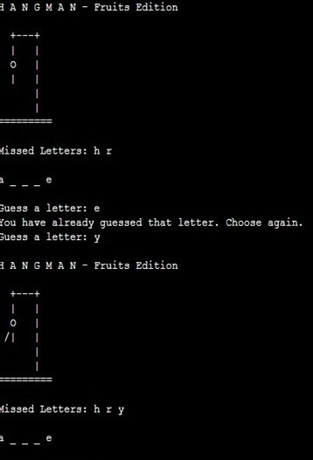


























Slide 6




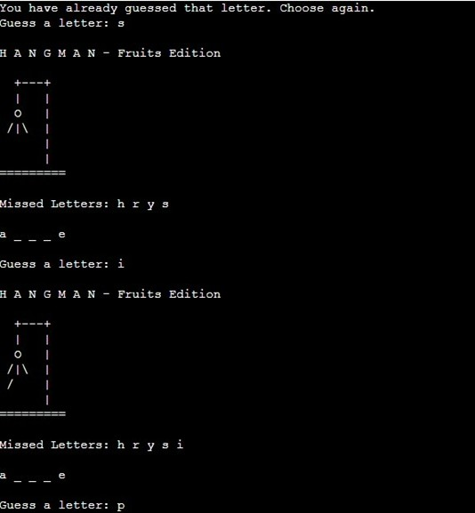
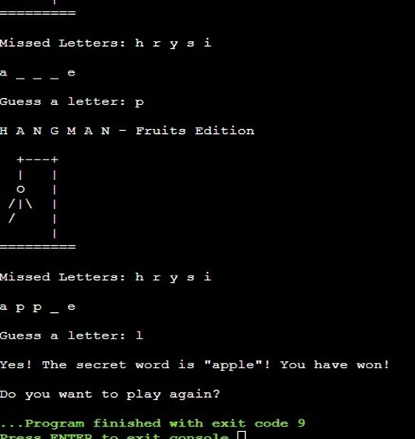








Slide 7
CONCLUSION
With this, we come to the end of the article. This was an easy approach to make the game of hangman in python. It can definitely be enhanced by using the Tkinter library or allowing more words as per the coder’s desire. The purpose of this article was to provide a simplistic approach to develop the game of hangman in python.
However, if you have any doubts or questions, do let me know in the comment section below. I will try to help you as soon as possible

Slide 8

















